Slide 1


Slide 2
Set Apart For His Glory - 4
Living as a Set Apart Ones – 4:25-32
Sunny Daniels , Thurrock Christian Fellowship
Sunday 12th April 2026

Slide 3
Living as Set Apart Ones: Book of Ephesians Overview
Andy’s Final Thoughts…
“Find out what pleases the Lord” (Ephesians 5:10). Not Law.
Four reasons to please God, to live ‘Set Apart’ lives:
  Gratitude for His love and kindness towards us
  Glory goes to God Himself (“Set Apart for His Glory!”)
  We can Gaze upon his majesty, beauty and power!
A ‘finely tuned’ F1 racing car has power to travel at high speeds
  As we live ‘Set Apart’ lives, we Gain Momentum and move effortlessly in the power of God!

Slide 4


Maintain (v3) and attain (v13) unity by love (v2, 15, 16) by ministering to each other (v12) with the gifts of Christ (v7) centrally speaking to each other the truth about Christ (v15) as you are equipped by Christ given shepherds and teachers (v11, 12)
Unity the Prime Directive
The Ultimate Boil Down !!!

Slide 5
Set Apart For His Glory - 3
1.Set Apart to Live In Union with Christ
2.Christ in Us and
Us in Christ

Slide 6
Set Apart For His Glory: Book of Ephesians Overview
Ephesians Chapters 4 – 6: Topics to Cover
UNITY is the ‘Prime Directive’ (4:1-16) John
Living as ‘SET APART’ ones (‘Holy’) (4:17-24) Phil
Putting OFF and Putting ON (4:25-32) Sunny
Living as ‘Children of Light’ (5:1-14) David
Getting Drunk on the Holy Spirit (5:15-21) Gillian
Submission in Christian Marriage (5:22-33) Judith
Submission in Home and Workplace (6:1-9) Oyin
Putting On the Armour of God (6:10-20) Andy

Slide 7
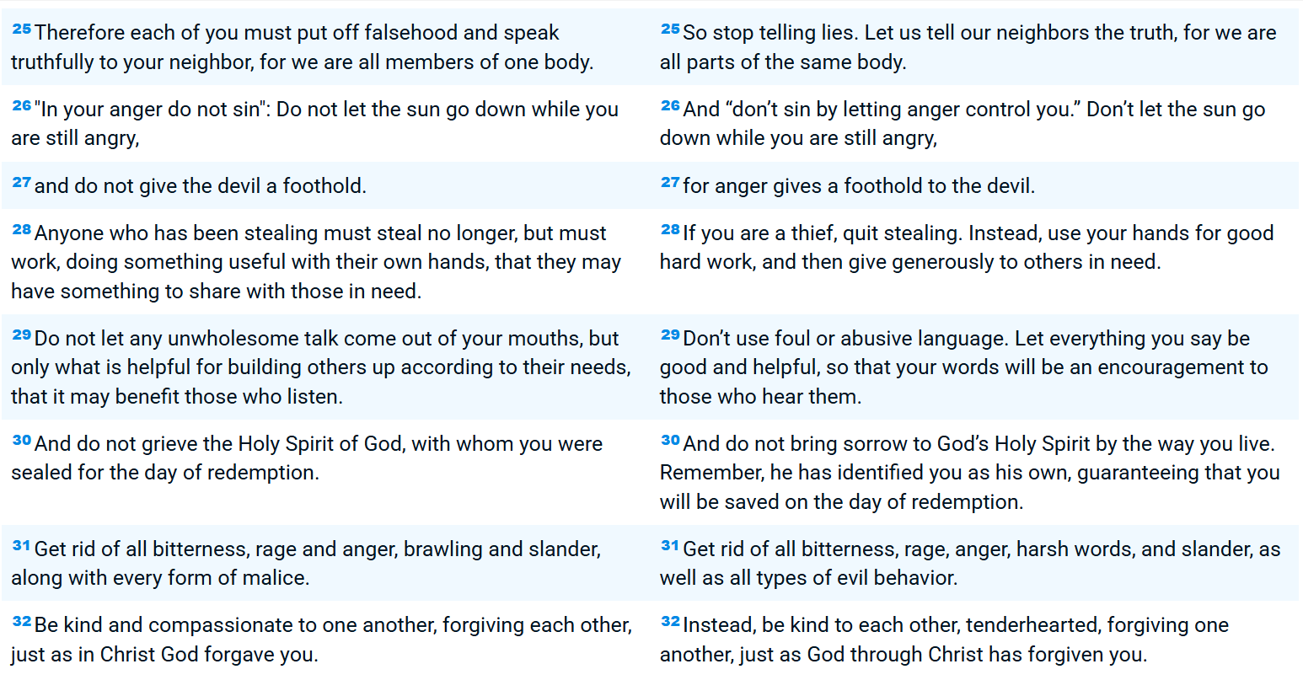
Part 4: Living as Set Apart Ones
MAIN TEXT : Ephesians 4:25-32
New Living Translation (NIV)
New Living Translation (NLT)

Slide 8
Part 4: Living as Set Apart Ones
SCRIPTURES
Matt 9:17. Neither do people pour new wine into old wineskins. If they do, the skins will burst; the wine will run out, and the wineskins will be ruined. No, they pour new wine into new wineskins, and both are preserved.’
2 Corinth 5:17 Therefore, if anyone is in Christ, the new creation has come: the old has gone, the new is here! NIV. Therefore, if anyone is in Christ, he is a new creation; old things have passed away; behold, all things have become new. NKJV
2 Peter 1:1-4. Simon Peter, a bondservant and apostle of Jesus Christ, To those who have obtained like precious faith with us by the righteousness of our God and Savior Jesus Christ:2 Grace and peace be multiplied to you in the knowledge of God and of Jesus our Lord, 3 as His divine power has given to us all things that pertain to life and godliness, through the knowledge of Him who called us by glory and virtue, 4 by which have been given to us exceedingly great and precious promises, that through these you may be partakers of the divine nature, having escaped the corruption that is in the world through lust.

Slide 9
Part 4: Living as Set Apart Ones
SCRIPTURES
1 John 3:2 See what great love. the Father has lavished on us, that we should be called children of God! And that is what we are! The reason the world does not know us is that it did not know him. 2 Dear friends, now we are children of God, and what we will be has not yet been made known. But we know that when Christ appears, we shall be like him, for we shall see him as he is. 3 All who have this hope in him purify themselves, just as he is pure.
John 10:34-36. 34 Jesus answered them, “Is it not written in your Law, ‘I have said you are “gods”’]? 35 If he called them ‘gods,’ to whom the word of God came—and Scripture cannot be set aside— 36 what about the one whom the Father set apart as his very own and sent into the world? Why then do you accuse me of blasphemy because I said, ‘I am God’s Son’?
in Psalms 40:20 says A man who is in honor, yet does not understand,Is like the beasts that perish.
Colossians 2:11-15 11 In him you were also circumcised with a circumcision not performed by human hands. Your whole self ruled by the flesh was put off when you were circumcised by Christ

Slide 10
Part 4: Living as Set Apart Ones
Today’s Study at a Glance
We must put off our old self because that is the bone of contention, Jesus would have crucified Satan on the cross if the devil was the problem but rather, he crucified the flesh on the cross and still ask us to continually put it to death
Only compatible software work in compatible operating systems.
We are the new creation and cannot participate in the divine nature if we remain stock in our old ways.
We can grieve the Holy Spirit by the way we talk and live, we don’t want to be in that space because The Holy spirit is our guarantee for salvation

